Slide 1


COVID-19 Analysis

Slide 2

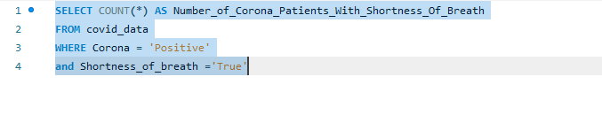
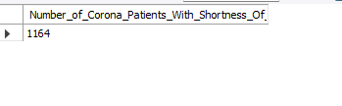
1-Find the number of Corona patients who faced shortness of breath.

Slide 3
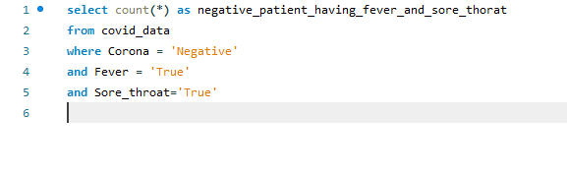

2-Find the number of negative corona patients who have a fever and sore throat.

Slide 4
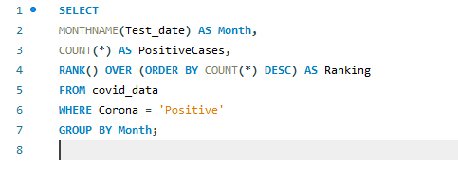
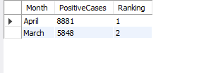
3-Group the data by month and rank the number of positive cases..

Slide 5
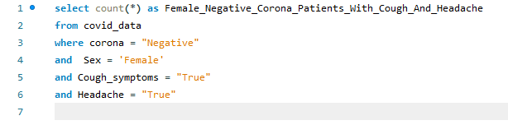

4-Find the female negative corona patients who faced cough and headache

Slide 6
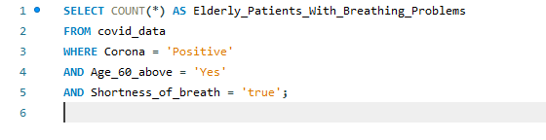

5-How many elderly corona patients have faced breathing problems?

Slide 7
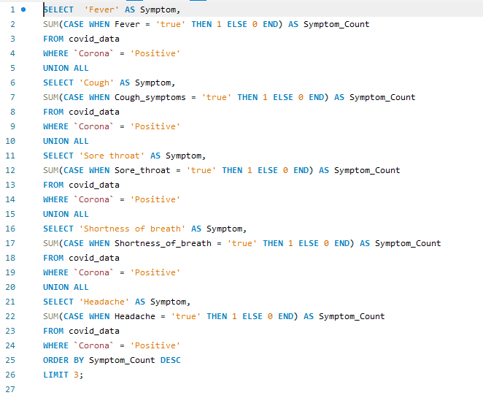

6-Which three symptoms were more common among COVID-19-positive patients?

Slide 8
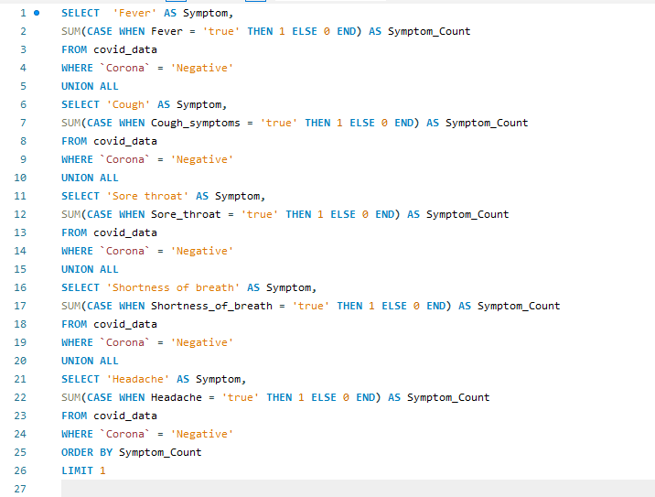

7-Which symptom was less common among COVID negative people?

Slide 9
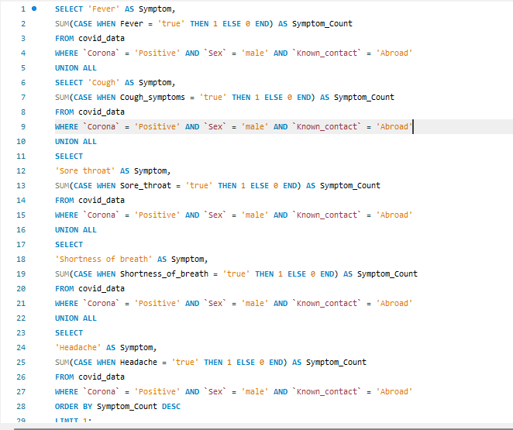

8-What are the most common symptoms among COVID-19-positive males whose known contact was abroad?

